Slide 1

Cube runner
Mithil Mistry (22dcs049)
Kevin Patel (22dcs063)
Htet Lwin Kyaw (22dcs025)

Slide 2
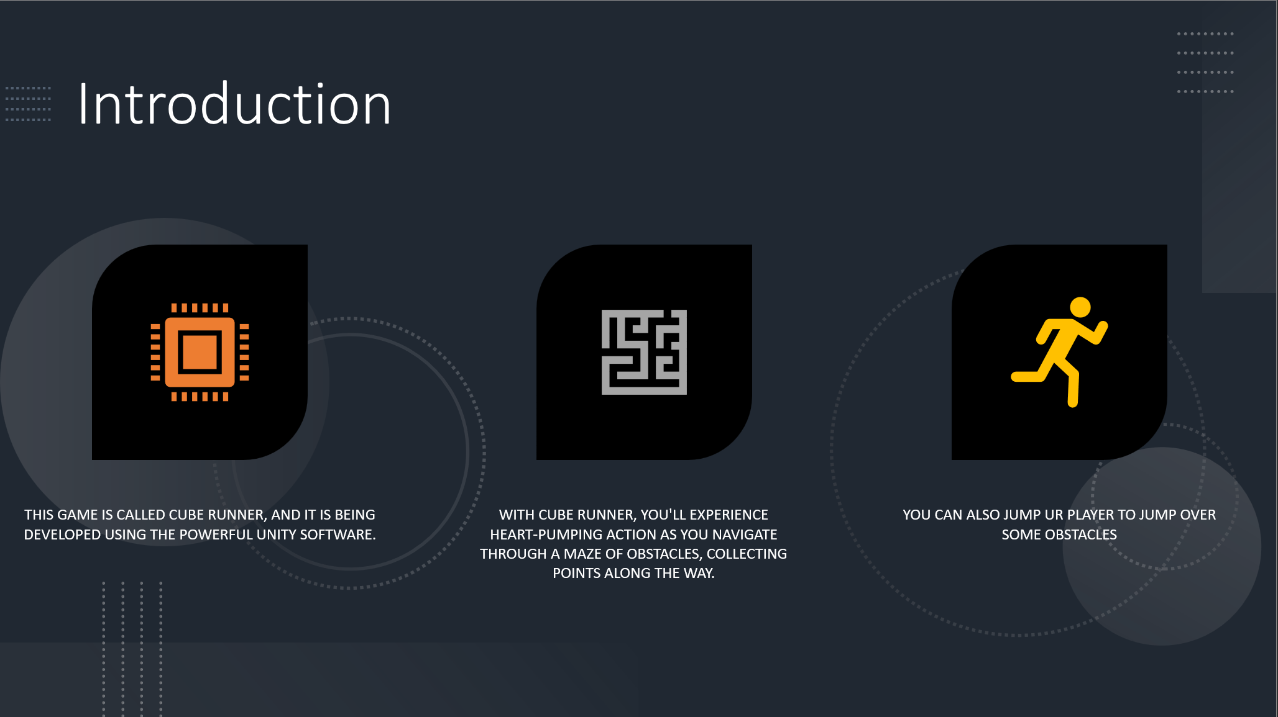
Introduction
This game is called Cube Runner and it is being developed using the powerful Unity software.
With Cube Runner, you'll experience heart-pumping action as you navigate through a maze of obstacles, collecting points along the way.
You can also jump ur player to jump over some obstacles

Slide 3
Project description
Cube Runner game in Unity is a simple yet engaging 3D endless runner game where the player controls a cube-shaped character that moves forward automatically, and the player's goal is to avoid obstacles while trying to survive as long as possible
The game is played from a third -person perspective, giving players a sense of immersion
The controls are easy to learn with players using the arrow keys to move left, right, up, and down while using the space key to jump
As players progress through the game, the obstacles become more challenging and the pace becomes faster, keeping players on their toes and engaged in the gameplay.

Slide 4

Why use unity software ?
Unity is a powerful game development engine that has revolutionized the industry. Its intuitive interface and robust toolset make it an ideal choice for developers of all skill levels.
One of the key benefits of Unity is its ability to export games to multiple platforms with ease. This means that developers can create a game once and then deploy it to a variety of different devices, including smartphones, tablets, and desktop computers.
Plus unity uses C# language to write the scripts so that’s a relatively easy language to learn if the developer already has the knowledge of C and C++

Slide 5
Working
The game is played using the arrow directional keys where the cube moves left when we press the left key and right when we press the right key
When we press the space bar , the cube jumps to skip over obstacles
This all is possible throught scripting in C#
The game also contains the game elements that are the objects you see in the game

Slide 6
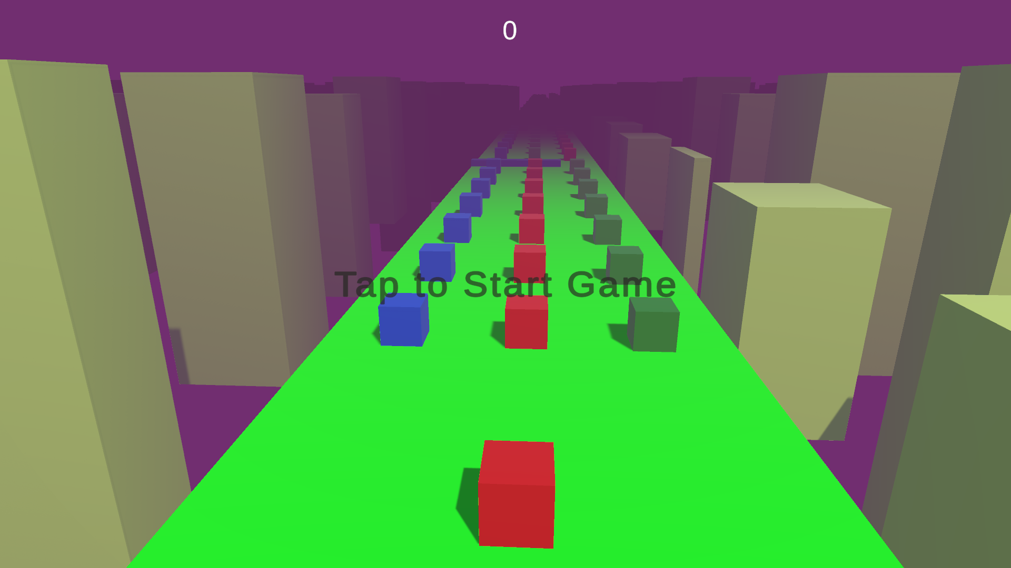
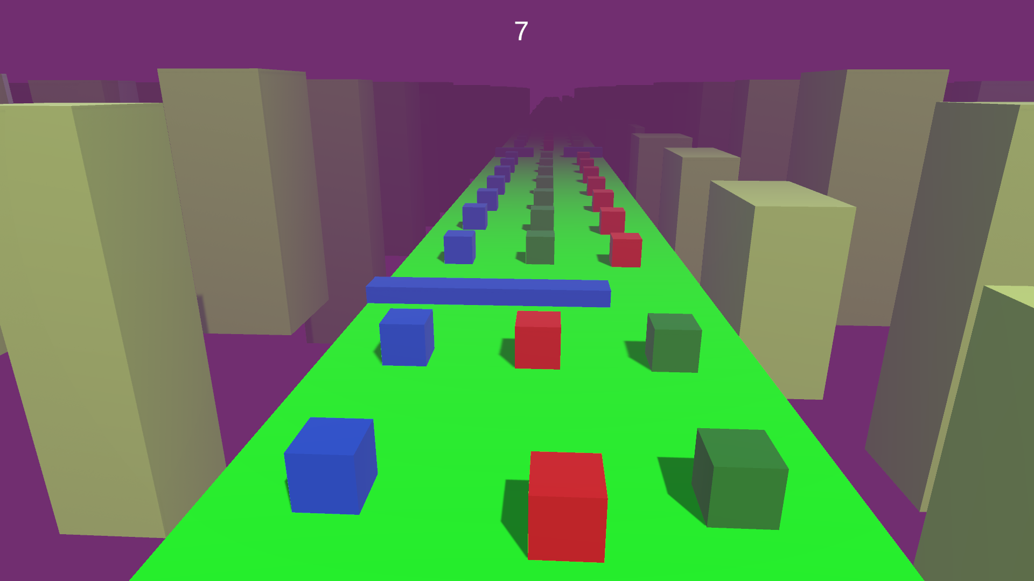
This is the starting of the game
This is the game play

Slide 7
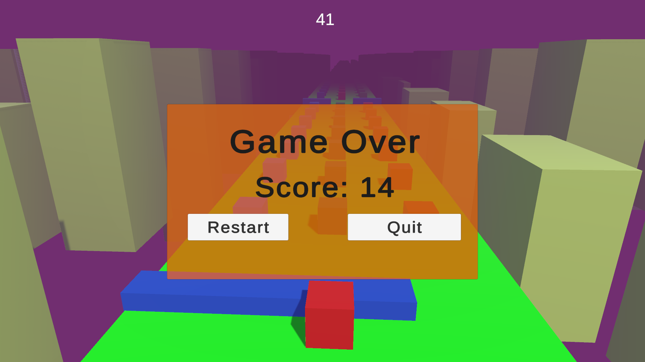
This is the page that overlays when u hit any obstacle and the game ends

Slide 8
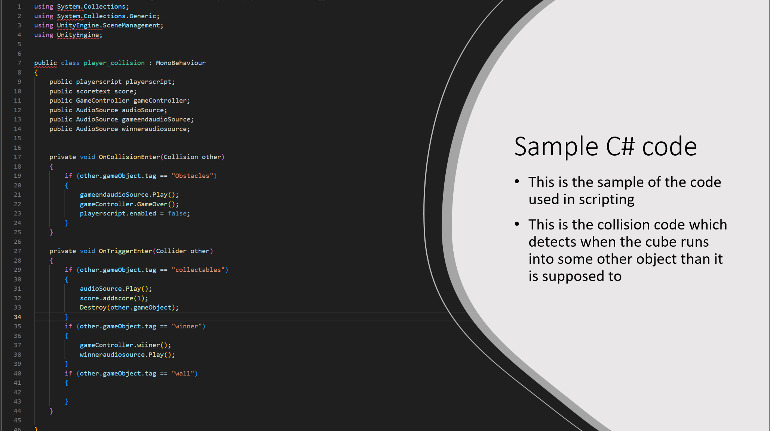

Slide 9
Future enhancements
In future we are planning to fix the things that are currently now working
Introduce new maps with different difficulties and more faster gameplay
Improve the graphics for a more immersive experience
Include support for saving the game data on the user’s machine

Slide 10
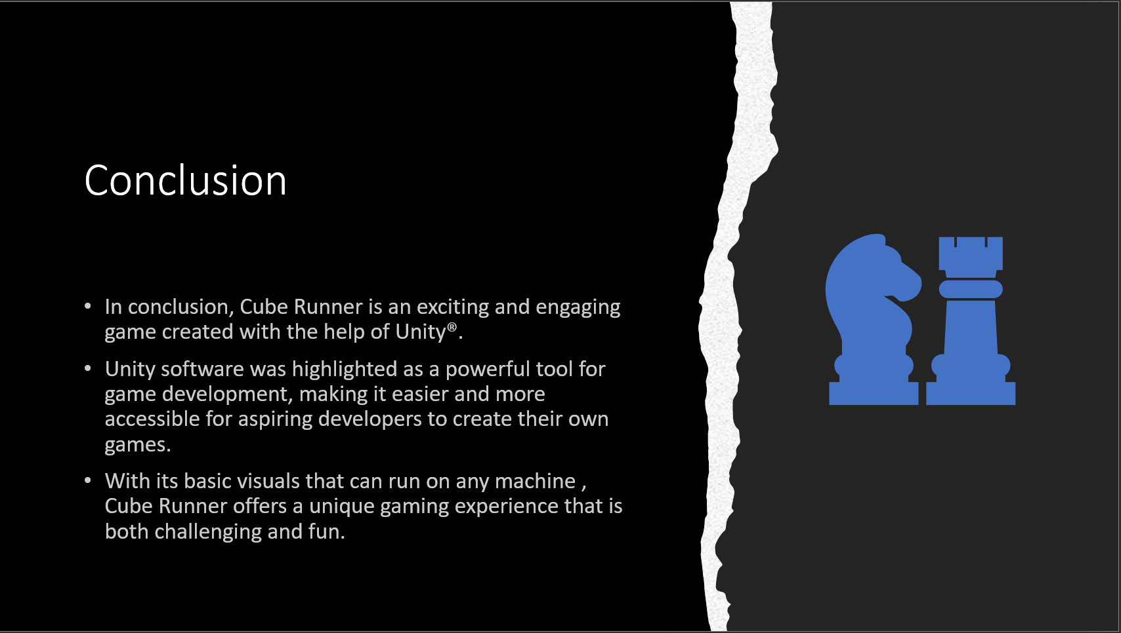

Slide 11
References
Unity Real-Time Development Platform | 3D, 2D, VR & AR Engine
Unity - Manual: Unity User Manual 2022.3 (LTS) (unity3d.com)

